Slide 1
Pothole App AI-Driven Road Damage Detection
Danish Shahzad
Maxx Richard Rahman
Notes:
The aim of the project is to
Identify and localize poor road conditions (mainly potholes) based on real-time images from mobile devices.

Slide 2
Outline
Domain/Data Analysis
Stage 1: ML Lifecycle
Stage 2: Model Optimization and Deployment
Challenges
Future Goals
Notes:
My outline of the presentation is as follows
First I will briefly explain dataset analysis
Why we choose specific model
How we were able to deploy model on mobile devices
Challenges
Future direction

Slide 3
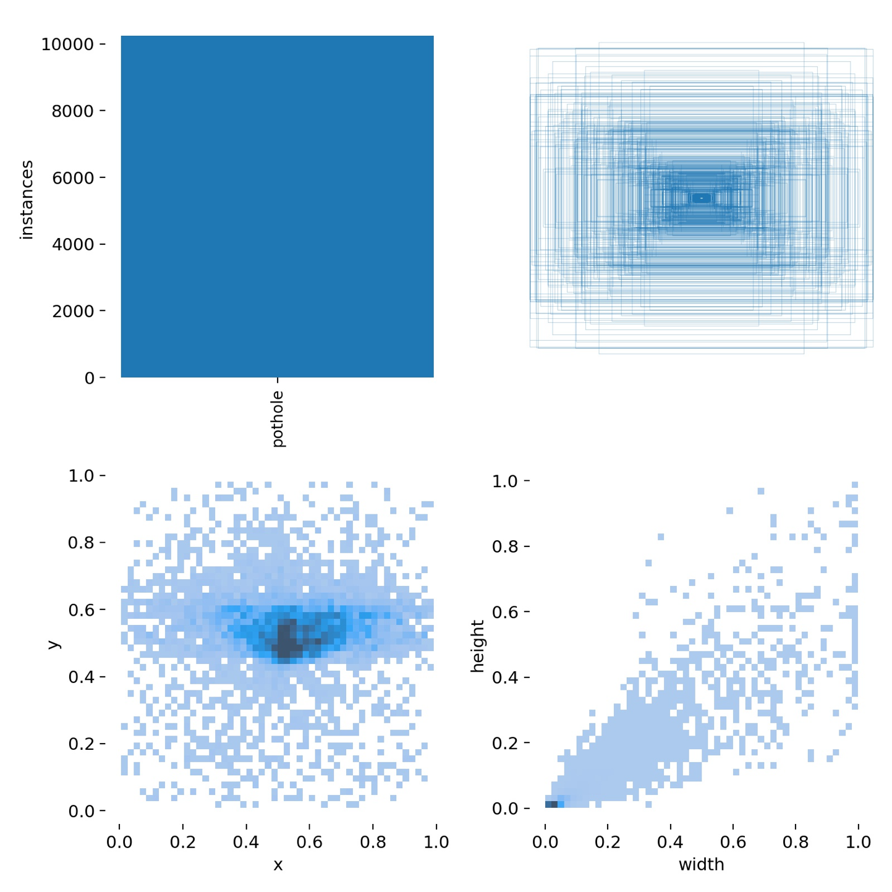
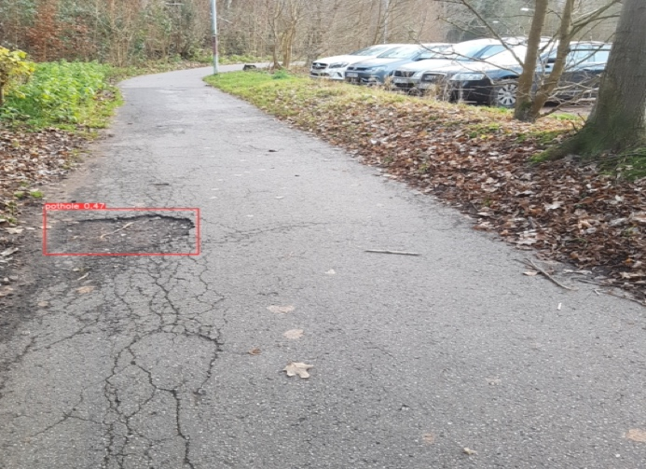
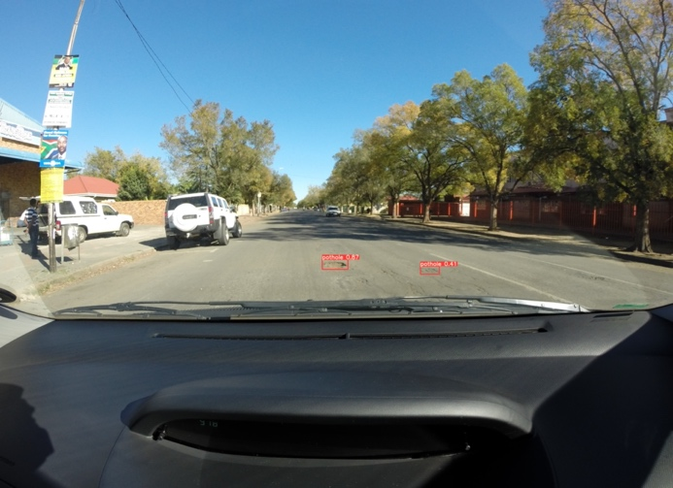
Domain/Data Analysis
Kaggle: Booysen and Kroon 2015 | Street View
Kaggle: Praramadhan 2021
Roboflow: Atikur Chitholian 2020
RDD2020: Road damage detection challenge 2020 | Drive View
Total Images | 4832
Training | 3948
Validation | 642
Calibration & Testing | 242
Notes:
We have roughly 4800 labeled images in our dataset. The dataset is combined by selecting images from different datasets which are publicaly available
Much portion of the dataset consist of drive view images roughly 54% from road damage detection challenge 2020.
Other 46% images belongs to street view images
In total we have 10,000 potholes in our entire dataset
But what can we say about health of dataset lets understand with these plots
In term of spatial extent (x, y) location we have a gaussian distribution. Much of the potholes appeared in this region
What can we say about size extent, well size is tricky due to perspective transformation
We are looking for something which is embedded on roads and only visible 100% if we are orthogonal to potholes

Slide 4
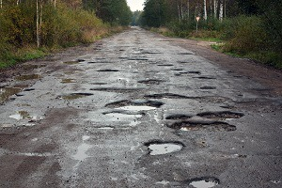
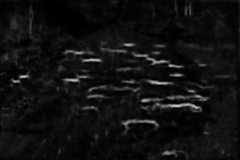
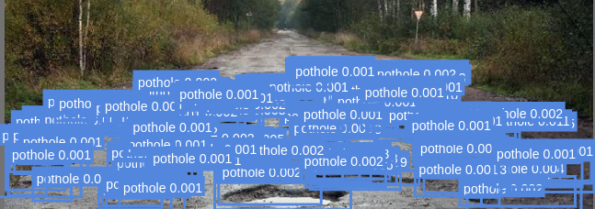
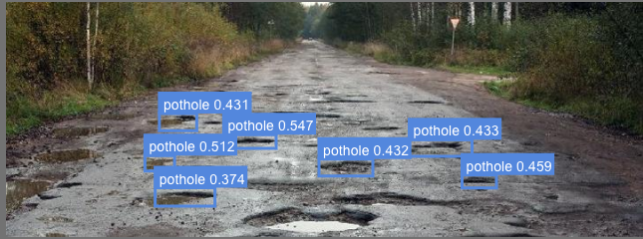
Stage 1: ML Lifecycle
Characteristics & Approach | Generative | Discriminative
Learns | Latent code | Mapping (X->Y)
Inference Speed | Slow | Fast
Generalization | Moderate | Poor
Deep-crack (Generative)
Faster-RCNN
(Discriminative)
Yolov5-s
(Discriminative)
Input
Notes:
In perspective transformation, potholes near are clearly visible but far ones looks like cracks/edges parallel to horizontal axis.
The height component vanishes, this makes a great challenge because we have much restriction in our perspective extent
Deepcrack gives us the crack like structures, it is generative approach. We can learn the latent code, it can generalize for other environment settings but not on unseen perspective shifts
Discriminative approaches SSD, YOLO and RCNN performs mapping from X->Y, eventhough we have speed gain at inference but with poor genalization

Slide 5
How to address Domain Shift?
Augmentations
hsv_h: 0.015 | HSV-Hue augmentation (fraction)
hsv_s: 0.7 | HSV-Saturation augmentation (fraction)
hsv_v: 0.4 | HSV-Value augmentation (fraction)
degrees: 0.0 | Rotation (+/- deg)
translate: 0.1 | Translation (+/- fraction)
scale: 0.5 | Scale (+/- gain)
shear: 0.0 | Shear (+/- deg)
perspective: 0.0 | Perspective (+/- fraction), range 0-0.001
flipud: 0.0 | Flip up-down (probability)
fliplr: 0.5 | Flip left-right (probability)
mosaic: 1.0 | Mosaic (probability)
mixup: 0.0 | Mixup (probability)
Notes:
One strategy active these days is to perform augmentation to address domain gap between source and target domain.
However perspective can not be handled in this generalize framework.
Luminance, translation, slight rotations and size variances can be addressed with these augmentation. That is why we employed these augmentations in our training pipeline

Slide 6
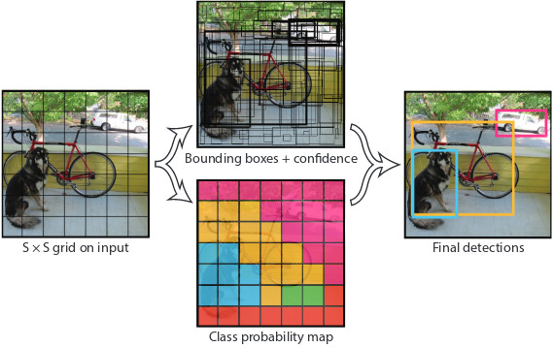
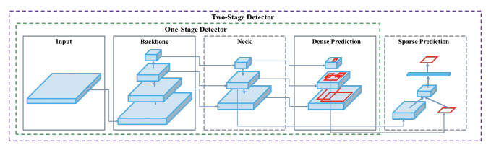
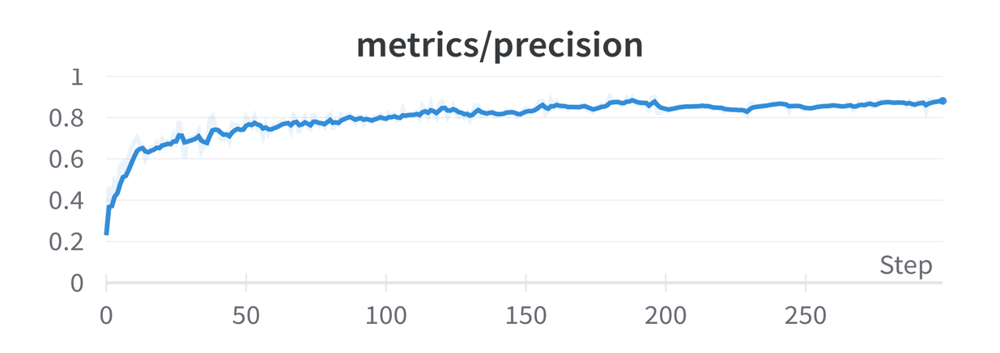
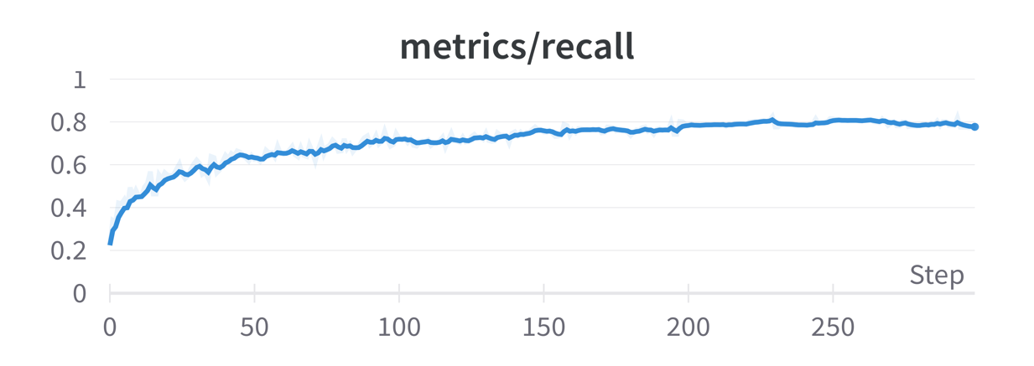
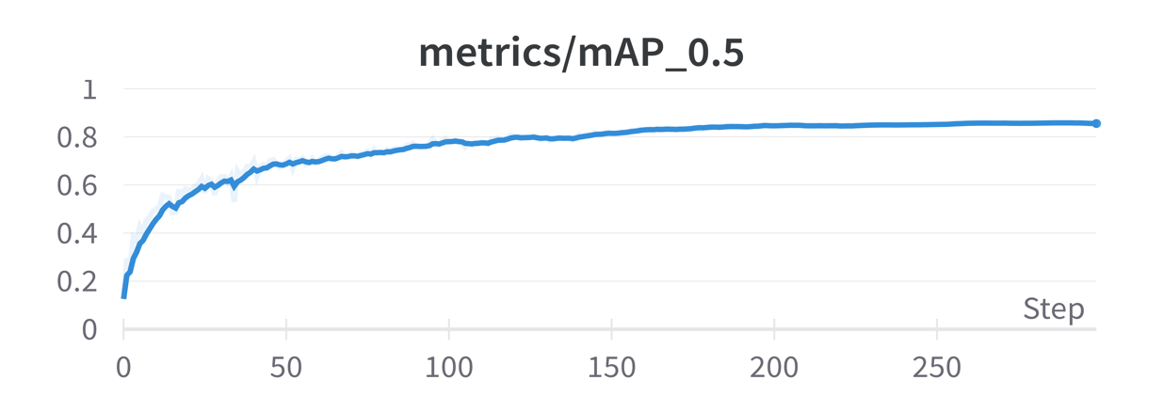
Model (YOLO) Overview
0.88
0.77
0.85
Notes:
Some words about YOLO
Yolo model is a single shot detector and performs detection as a regression problem.
It divides the image into an S × S grid
for each grid cell Yolo predicts bounding boxes, associated confidence for those bboxes, and C class probabilities.
For this purpose yolo network consists of three main pieces.
1) Backbone - A CNN that that detects features at different scales.
2) Neck - Series of layers to combine image features corresponding to different scales.
3) Head - Generate bbox and class prediction.
The design of yolov5 also allow to increase capacity of the network by increasing depth and spatial width (receptive field)
metrics/mAP_0.5 ----0.8547
metrics/mAP_0.5:0.95 --- 0.4736
metrics/precision. ---- 0.8841
metrics/recall --- 0.7745
Evaluation Metrics
Accuracy: accuracy indicates how many of the images with potholes or and images without potholes are correctly identified (both True Positives and True Negatives) by the model.
Precision: to determine the fraction of potholes in images recognized by our model classifier that were really potholes or true positives
Recall: indicates the fraction of true values (true positives and true negatives) identified by our model that were really true positives or correctly identified images with potholes.

Slide 7
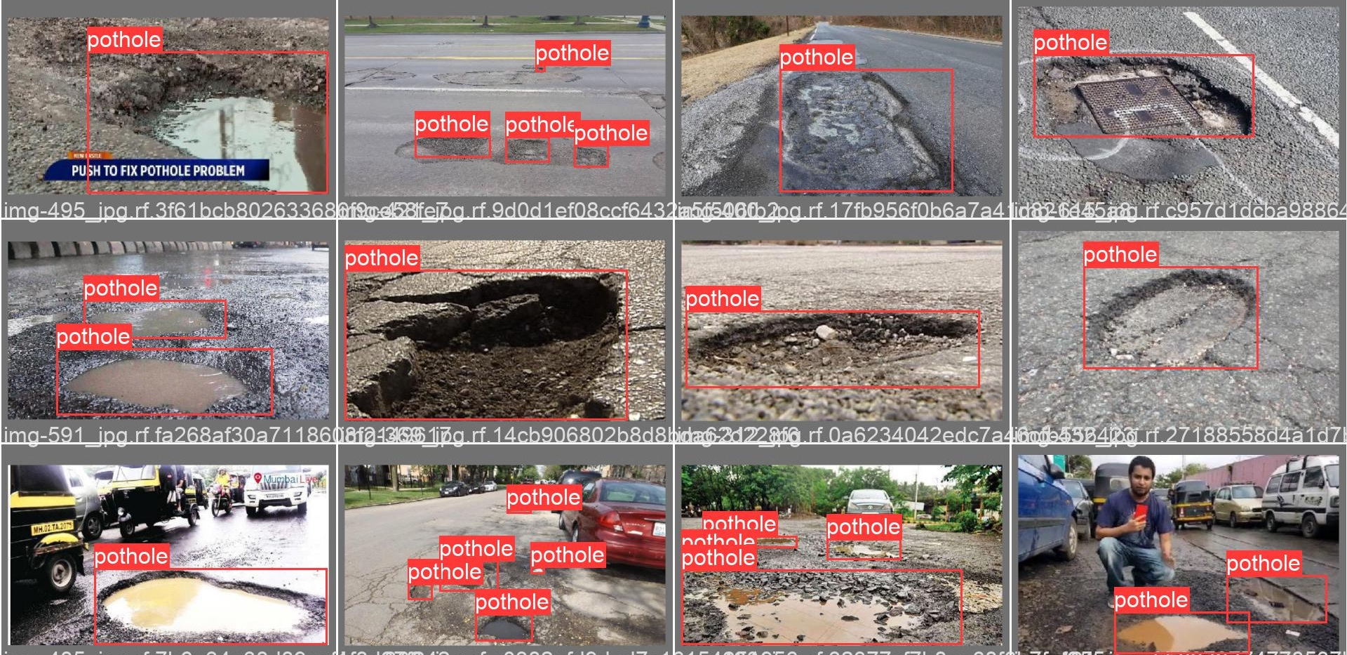
Street View
Notes:
These are some results on street view testset

Slide 8
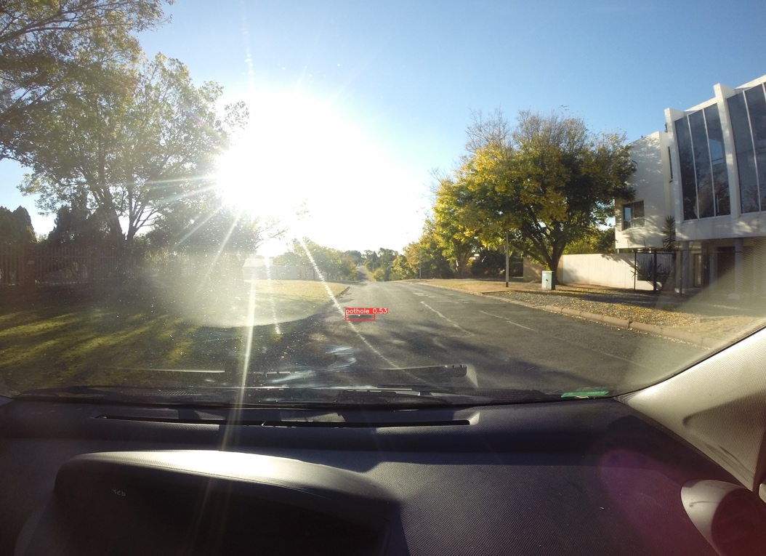
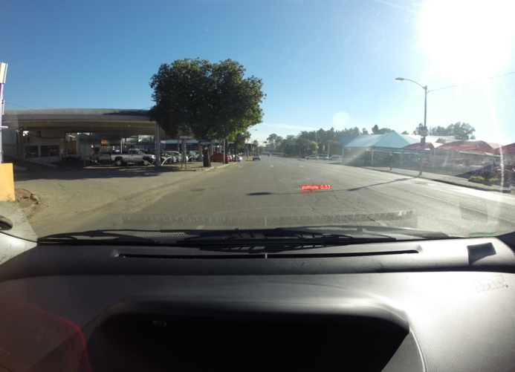
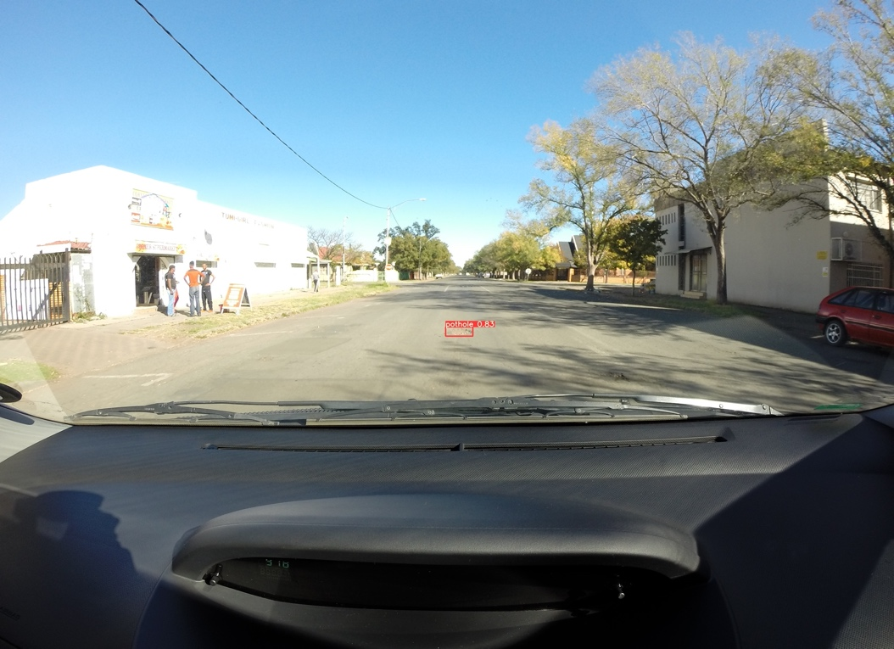
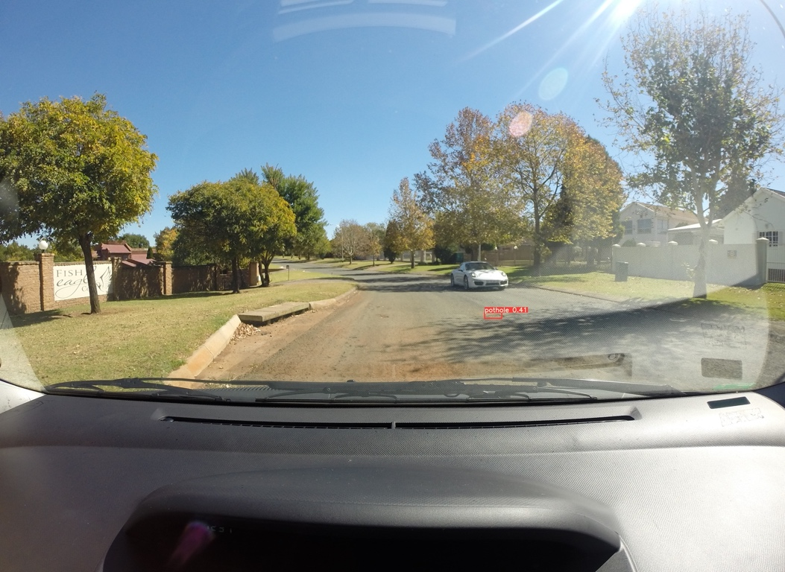
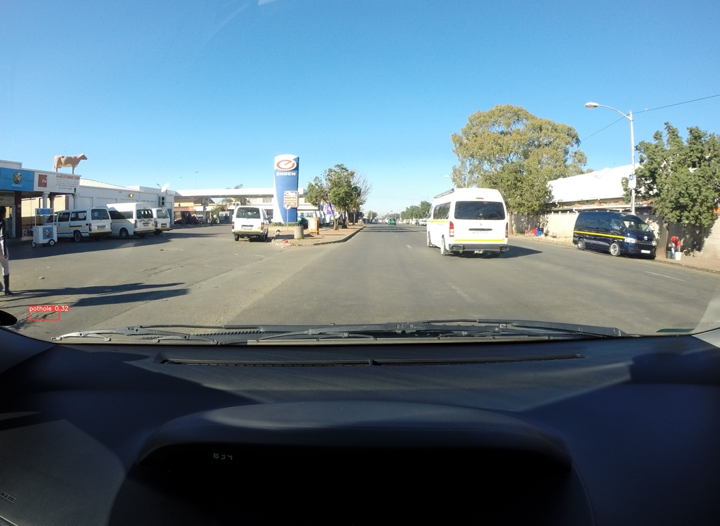
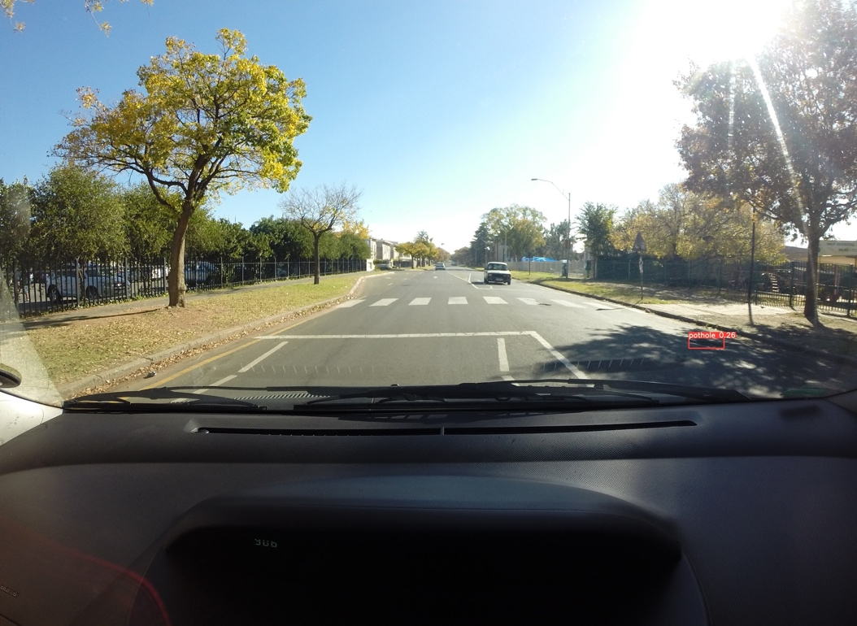
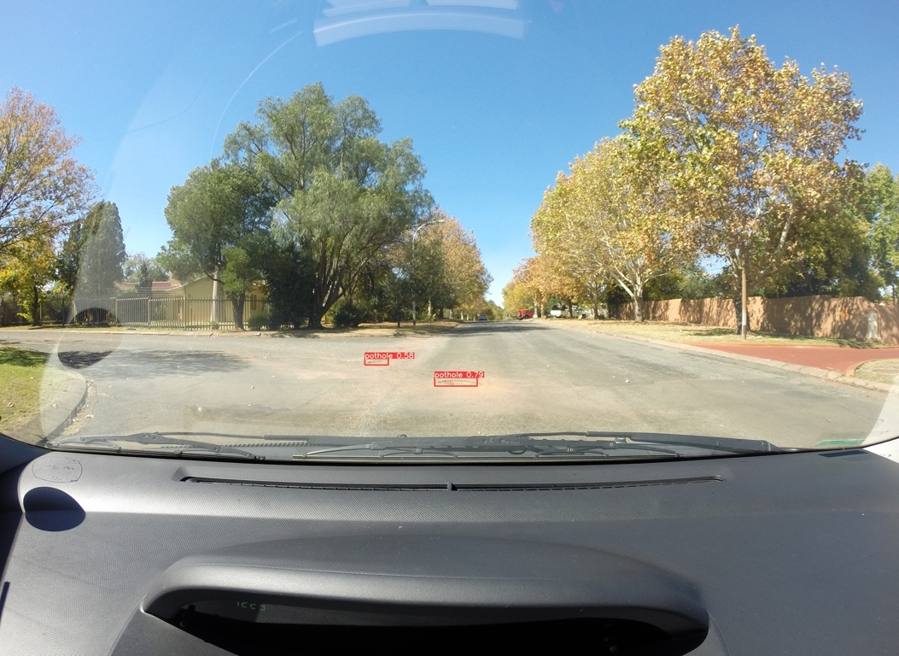
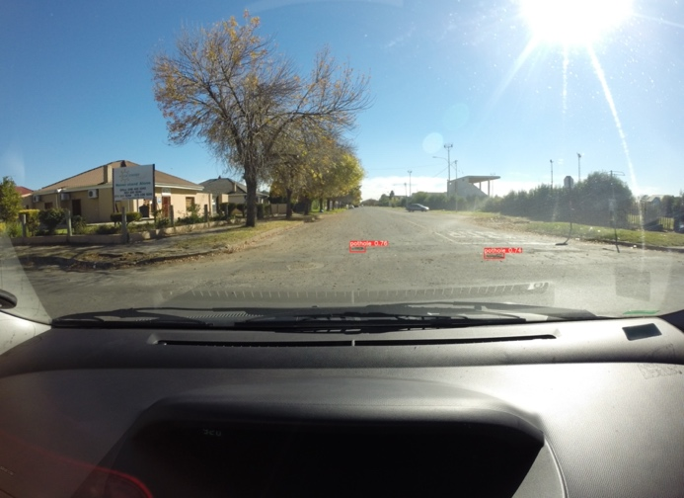
Drive View
Notes:
These are some results on drive view testset

Slide 9
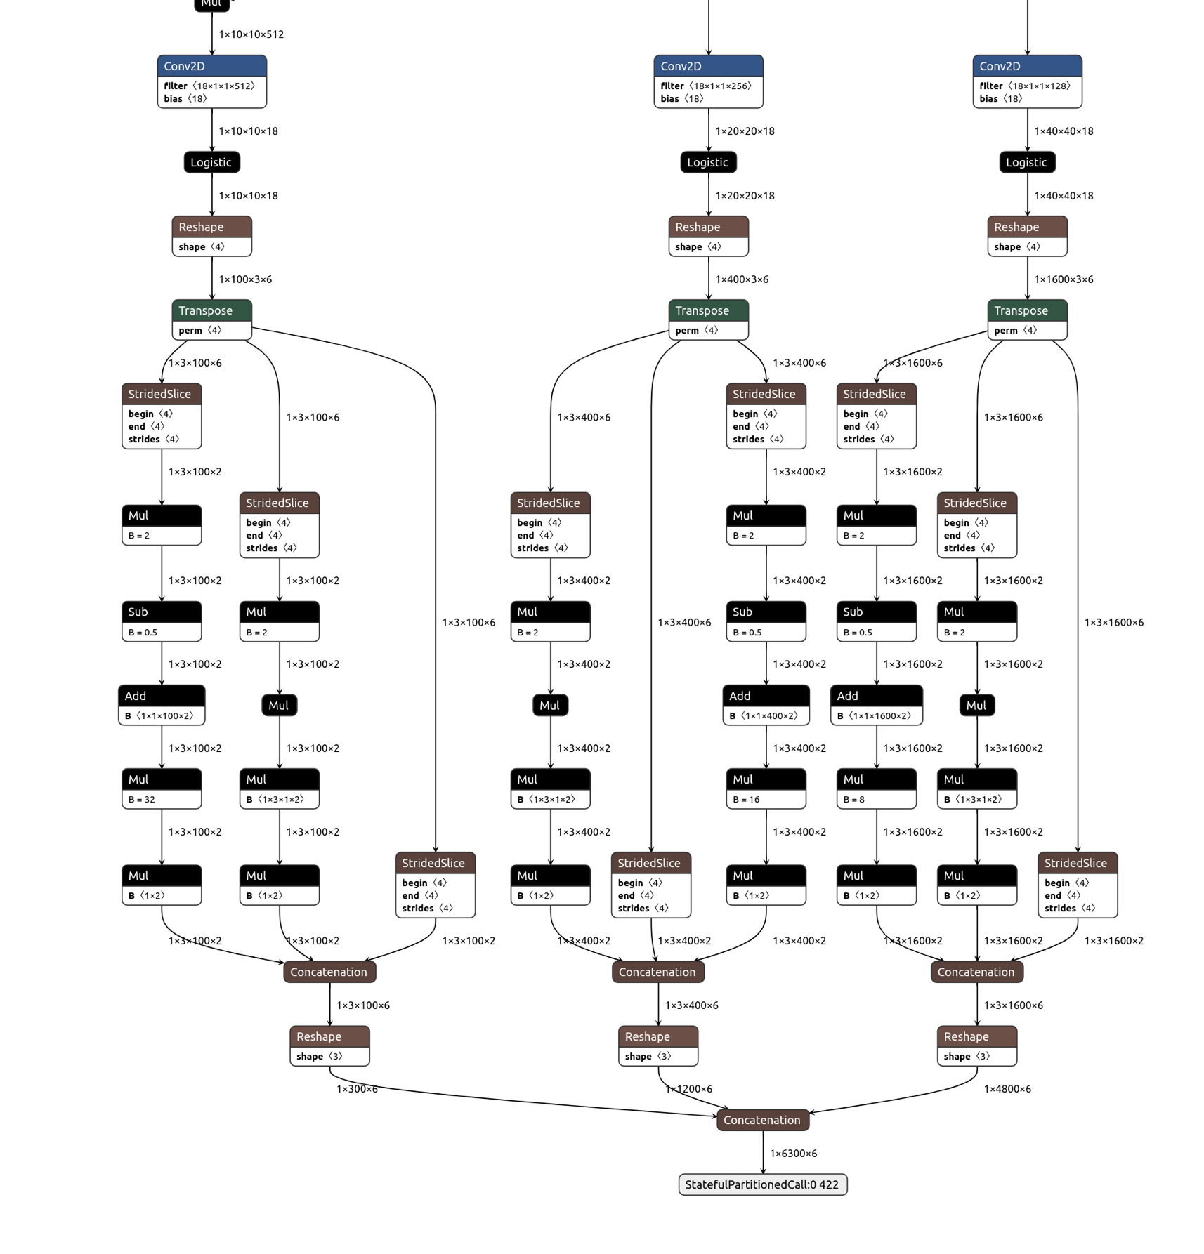
Stage 2: Deployment
PORTING NEURAL NETWORK MODELS ONTO MOBILE DEVICES
Core-ML | Specifically for iOS devices
Pytorch-Mobile for Android | Difficult to customize Beta stage
TensorFlow-Lite for Android | Stable framework Support model compression and quantization
 | FP32 | FP16 | INT8
Size | 25MB | 7.8MB | 7.1MB
FPS (Samsung G. S7) | 4 | 12 | Expected 15
Notes:
General Pytorch/Tensorflow model due to their complex design and used precision can be deployed on mobile & edge devices
however real time inference speed can not be achieved without some optimizations
Industrial insights suggests us to use strategies to convert ML model into different modality before deployment.
We were able to adapt these standards and achieve runtime that is more than ~3X faster during inference.
First stage is ONNX generation which generate graphical representation of the Network.
For IOS deployment we convert our model using CoreML from ONNX.
For android devices we were able to convert our model using Tensorflow-lite from ONNX.
Our implementation runs 12 FPS on S7 which can be further extended to 15 FPS with int8 quantization

Slide 10
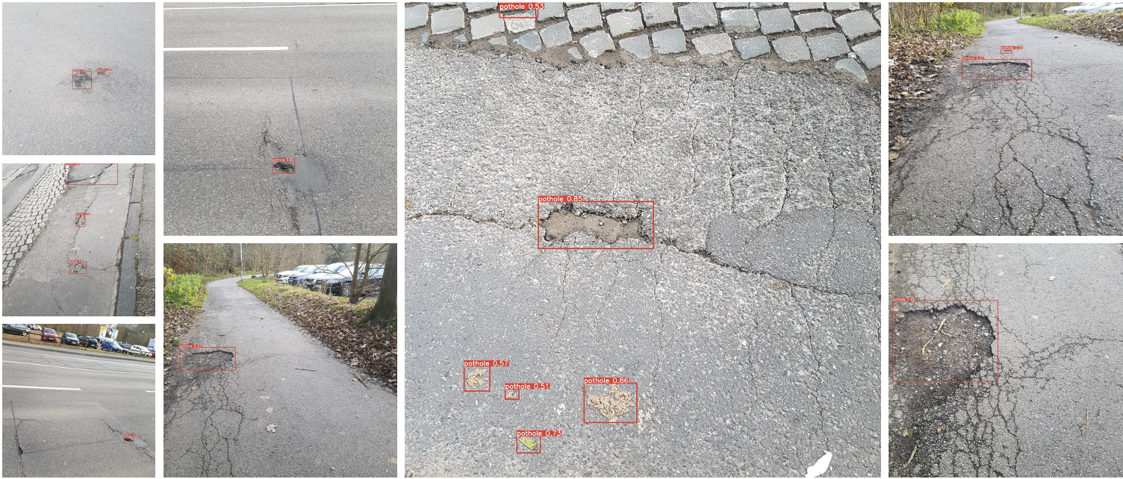
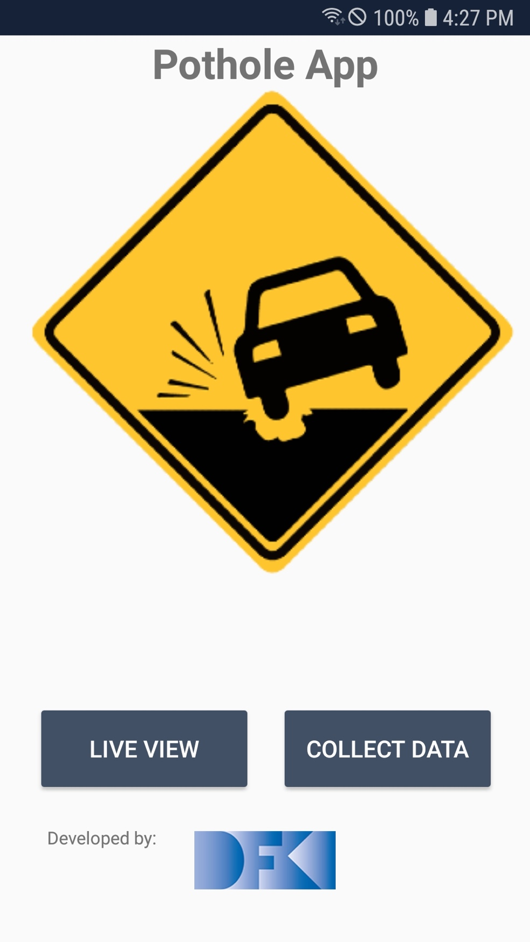
Data Acquisition
Name | Classification Label | Lat | Long
JPEG_20211215_120238_5476135251111400125.jpg | 0 | 49.254444 | 7.041389
JPEG_20211215_120306_4820368371280416322.jpg | 1 | 49.254444 | 7.041389
JPEG_20211220_132614_8117528908640746787.jpg | 0 | 49.237778 | 69.972224
JPEG_20211220_132754_7091145799984818778.jpg | 0 | 0 | 0
Notes:
In our app beside live view we also have acquisition module
Acquisition module save images on mobile device along with GPS and other sensor data. It also perform inference for pothole detection with a limited resolution 320x320.
Classification-labels can also be updated offline on high resolution stored images using much complex version of our trained model.
With GPS data images can be tagged on Global Mapper or ARCGIS to engage respective authorities

Slide 11
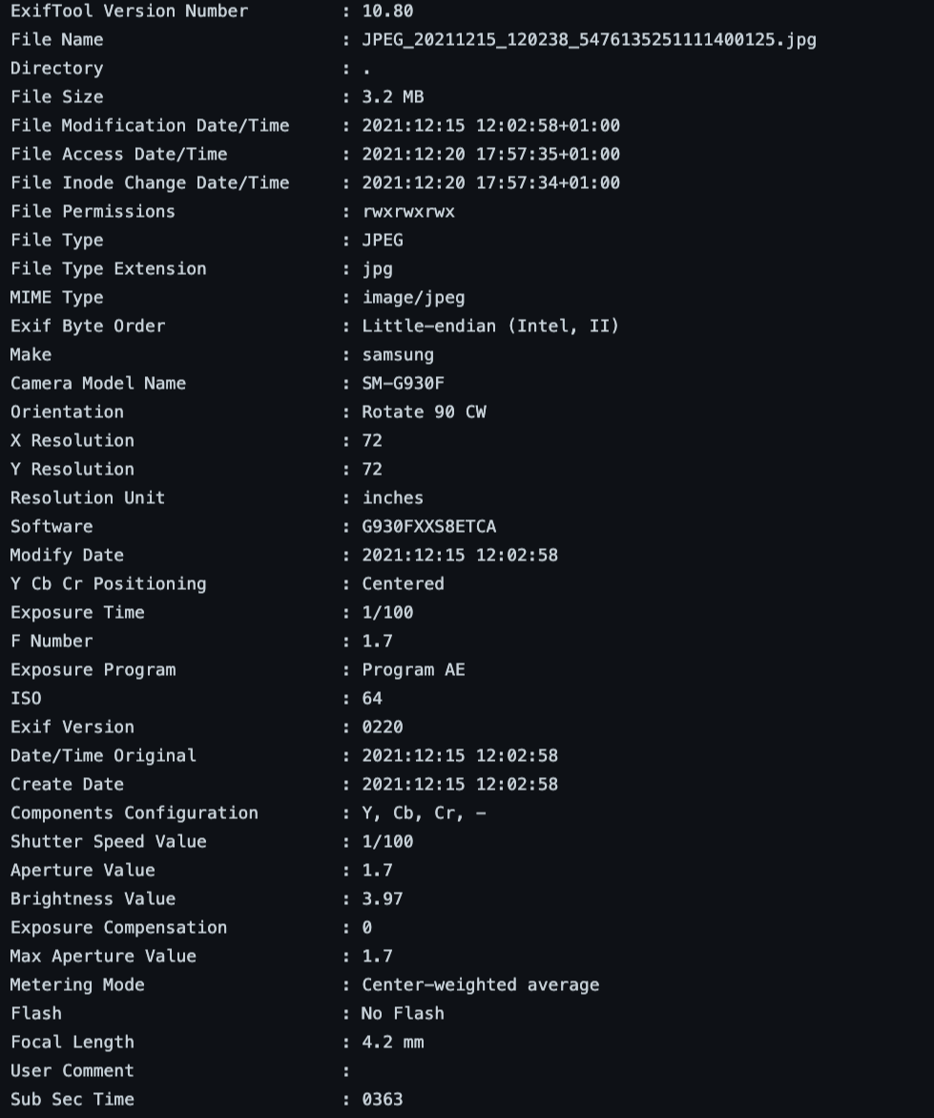
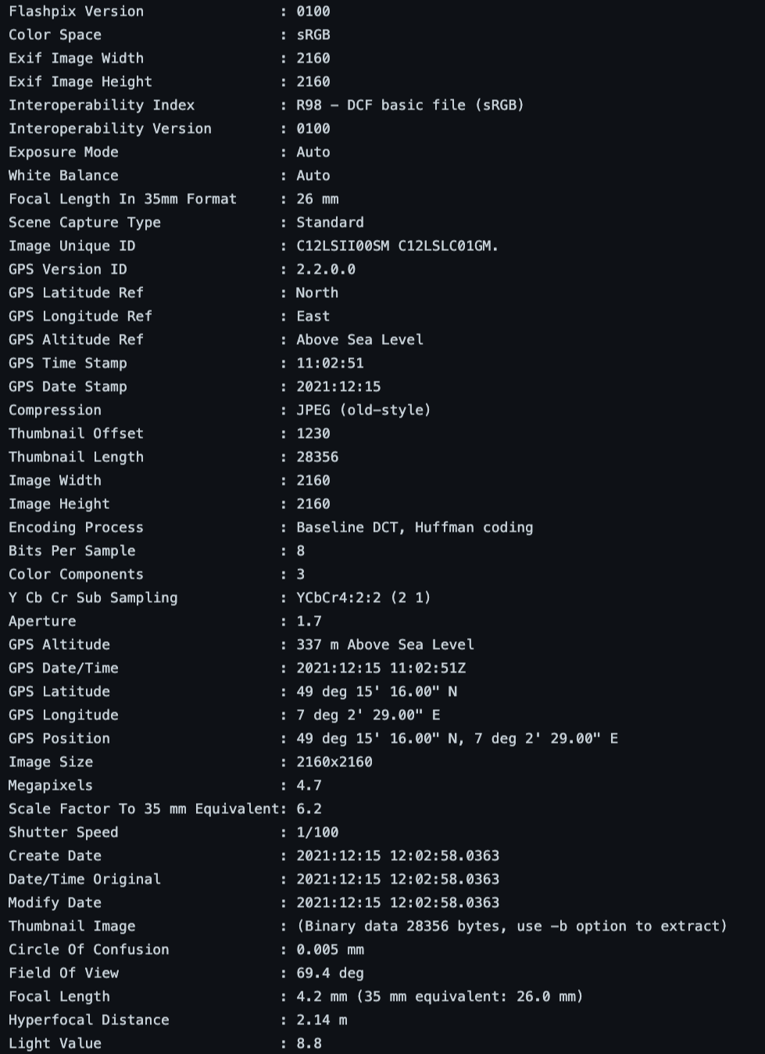
Data Acquisition
Notes:
Beside images and GPS information, all of the device sensor data is also stored. This metadata also contain much rich information about intrinsic and extrinsic parameters of camera, lighting condition and much other.

Slide 12
Future Goals
Dataset acquisition
Look for publication
Increase robustness
Address other road damage scenarios (cracks)
How additional sensory data can be utilized to support generalization
Notes:
I am working on other project related to visual inspection, however I am still interested to carry forward research and practical work in this domain
We can acquire dataset on different mobiles available in our groups to boost acquisition activity
With this data we can deduce some publications and make data available for a challenge
We can also increase robustness of our model in long run with new data
We can engage authorities for inline research task and get funding for all road damage scenarios
In addition we can look for meta assisted learning framework to address domain shift
That is all from my side

